Slide 1
Dynamic method dispatch

Slide 2
Definition
polymorphism in Java is a concept by which we can perform a single action in different ways. Polymorphism is derived from 2 Greek words: poly and morphs. The word "poly" means many and "morphs" means forms. So polymorphism means many forms.
There are two types of polymorphism in Java: compile-time polymorphism and runtime polymorphism. We can perform polymorphism in java by method overloading and method overriding.

Slide 3
Runtime Polymorphism in Java
Runtime polymorphism or Dynamic Method Dispatch is a process in which a call to an overridden method is resolved at runtime rather than compile-time.
In this process, an overridden method is called through the reference variable of a superclass. The determination of the method to be called is based on the object being referred to by the reference variable. Thus, this determination is made at run time.
At run-time, it depends on the type of the object being referred to (not the type of the reference variable) that determines which version of an overridden method will be executed
A superclass reference variable can refer to a subclass object. This is also known as upcasting. Java uses this fact to resolve calls to overridden methods at run time.

Slide 4
Upcasting
If the reference variable of Parent class refers to the object of Child class, it is known as upcasting.
For example:
class A{}
class B extends A{}
A a=new B();//upcasting

Slide 5
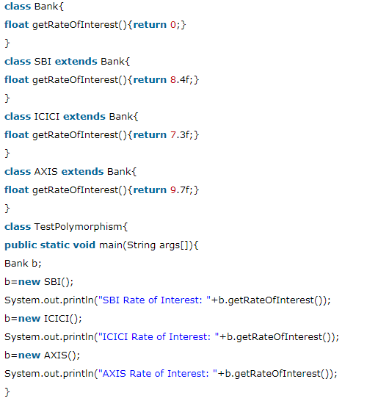

Slide 6
Advantages of Dynamic Method Dispatch
Dynamic method dispatch allow Java to support overriding of methods which is central for run-time polymorphism.
It allows a class to specify methods that will be common to all of its derivatives, while allowing subclasses to define the specific implementation of some or all of those methods.
It also allow subclasses to add its specific methods subclasses to define the specific implementation of some.

Slide 7
Abstract class in Java
A class which is declared with the abstract keyword is known as an abstract class in Java. It can have abstract and non-abstract methods (method with the body).
Abstraction in Java
Abstraction is a process of hiding the implementation details and showing only functionality to the user.
Another way, it shows only essential things to the user and hides the internal details, for example, sending SMS where you type the text and send the message. You don't know the internal processing about the message delivery.
Abstraction lets you focus on what the object does instead of how it does it.
Ways to achieve Abstraction
There are two ways to achieve abstraction in java
Abstract class (0 to 100%)
Interface (100%)

Slide 8
Abstract class in Java
A class which is declared as abstract is known as an abstract class. It can have abstract and non-abstract methods. It needs to be extended and its method implemented. It cannot be instantiated.
Rules
An abstract class must be declared with an abstract keyword.
It can have abstract and non-abstract methods.
It cannot be instantiated.
It can have constructors and static methods also.
It can have final methods which will force the subclass not to change the body of the method.

Slide 9
Abstract Method in Java
A method which is declared as abstract and does not have implementation is known as an abstract method.
Example of abstract method
abstract void printStatus();//no method body and abstract

Slide 10
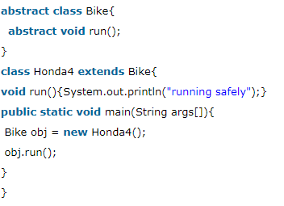
Example of Abstract class that has an abstract method
In this example, Bike is an abstract class that contains only one abstract method run. Its implementation is provided by the Honda class.

Slide 11
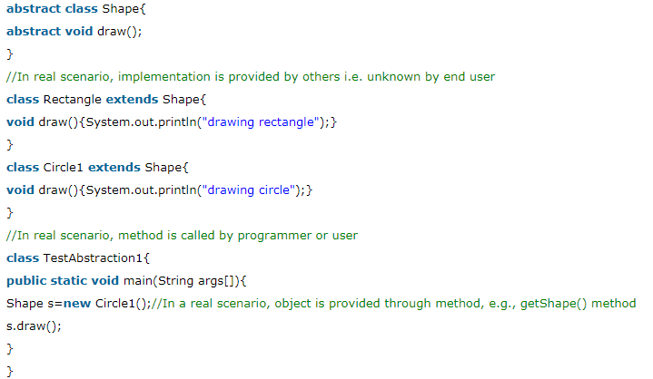
Example

Slide 12
Interface in Java
An interface in java is a blueprint of a class. It has static constants and abstract methods.
The interface in Java is a mechanism to achieve abstraction. There can be only abstract methods in the Java interface, not method body. It is used to achieve abstraction and multiple inheritance in Java.
In other words, you can say that interfaces can have abstract methods and variables. It cannot have a method body.
Java Interface also represents the IS-A relationship.
It cannot be instantiated just like the abstract class.
Since Java 8, we can have default and static methods in an interface.
Since Java 9, we can have private methods in an interface.

Slide 13
Why use Java interface?
There are mainly three reasons to use interface. They are given below.
It is used to achieve abstraction.
By interface, we can support the functionality of multiple inheritance.
It can be used to achieve loose coupling.

Slide 14
How to declare an interface?
An interface is declared by using the interface keyword. It provides total abstraction; means all the methods in an interface are declared with the empty body, and all the fields are public, static and final by default. A class that implements an interface must implement all the methods declared in the interface.
Syntax:
interface <interface_name>{
// declare constant fields
// declare methods that abstract
// by default.
}

Slide 15
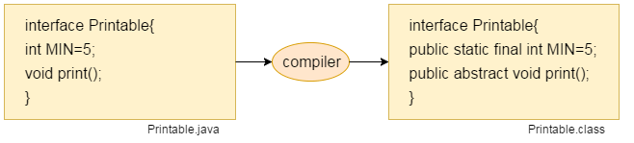
The Java compiler adds public and abstract keywords before the interface method. Moreover, it adds public, static and final keywords before data members.
In other words, Interface fields are public, static and final by default, and the methods are public and abstract.

Slide 16
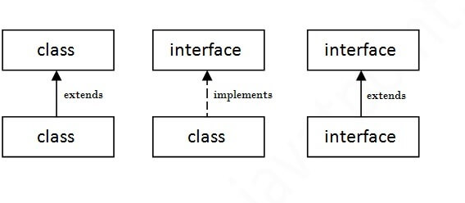
The relationship between classes and interfaces
As shown in the figure given below, a class extends another class, an interface extends another interface, but a class implements an interface.

Slide 17
Example
interface printable{
void print();
}
class A6 implements printable{
public void print(){System.out.println("Hello");}
public static void main(String args[]){
A6 obj = new A6();
obj.print();
}
}

Slide 18
Example
interface Bank{
float rateOfInterest();
}
class SBI implements Bank{
public float rateOfInterest(){return 9.15f;}
}
class PNB implements Bank{
public float rateOfInterest(){return 9.7f;}
}
class TestInterface2{
public static void main(String[] args){
Bank b=new SBI();
System.out.println("ROI: "+b.rateOfInterest());
}}

Slide 19
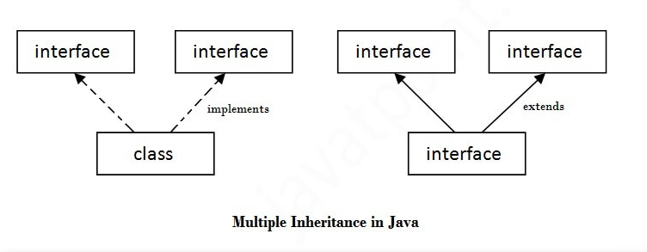
Multiple inheritance in Java by interface
If a class implements multiple interfaces, or an interface extends multiple interfaces, it is known as multiple inheritance.

Slide 20
interface Printable{
void print();
}
interface Showable{
void print();
}
class TestInterface3 implements Printable, Showable{
public void print(){System.out.println("Hello");}
public static void main(String args[]){
TestInterface3 obj = new TestInterface3();
obj.print();
}
}

Slide 21
Interface inheritance
A class implements an interface, but one interface extends another interface.
interface Printable{
void print();
}
interface Showable extends Printable{
void show();
}
class TestInterface4 implements Showable{
public void print(){System.out.println("Hello");}
public void show(){System.out.println("Welcome");}
public static void main(String args[]){
TestInterface4 obj = new TestInterface4();
obj.print();
obj.show();
}
}

